Slide 1
Harm reduction for smokers who do not want to quit: can we use tobacco policies to encourage switching to e-cigarettes?
TOPS, April 15th 2021
John Buckell, Senior Researcher, University of Oxford
Jody Sindelar, Professor, Yale School of Public Health
Paul Aveyard, Professor, University of Oxford
Lisa Fucito, Associate Professor, Yale School of Medicine
Suchitra Krishnan-Sarin, Professor, Yale School of Medicine
Stephanie O’Malley, Professor, Yale School of Medicine

Slide 2
Acknowledgement
Yale Center for the Study of Tobacco Product Use and Addiction: Flavors, Nicotine and Other Constituents (YCSTP). U54 DA036151-06 from the National Institute on Drug Abuse (NIDA) and FDA Center for Tobacco Products (CTP) to Yale University.

Slide 3
Overview
Summary of paper:
Introduction and background
Methods
Results
Discussion

Slide 4
Introduction and background

Slide 5
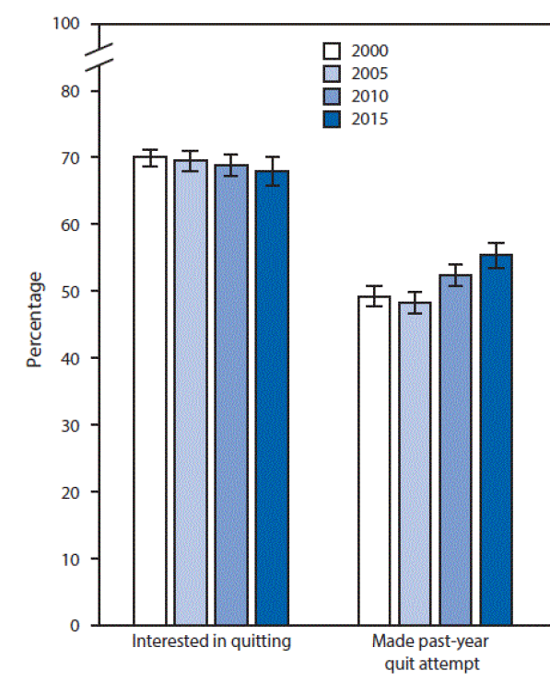
Problem
Around 30% of smokers are not interested in quitting cigarettes (NIQC). Growing %.
These smokers tend to be older and smoke heavily
These smokers are thus at higher risk of harm from tobacco
Need to be helped to prevent disease, delay death

Slide 6
How to help them quit?
Cessation treatments are available but are typically only provided to those that want to quit (Varenicline, NRT, counselling, etc.)
Policies have had some impact (taxes, information, etc.)
Proliferation of self-help tools (books, apps, healthy living, etc.)

Slide 7
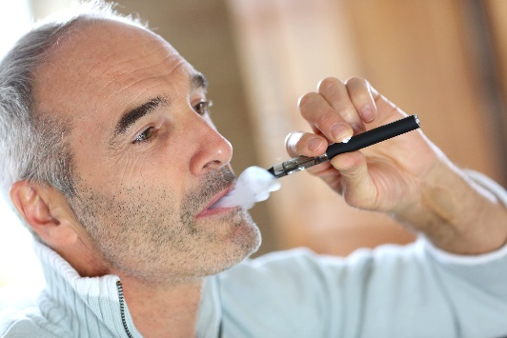
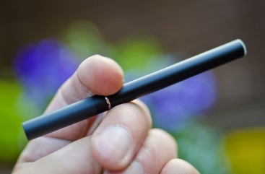

Switching to vaping as a way to help? Harm reduction approach.
Emerging evidence from RCTs suggests that e-cigarettes are appealing to some NIQC smokers
Cig-a-likes appeal to NIQC smokers
BUT: nicotine delivery slow, often bulky and/or complex devices
Would pod e-cigs appeal?

Slide 8
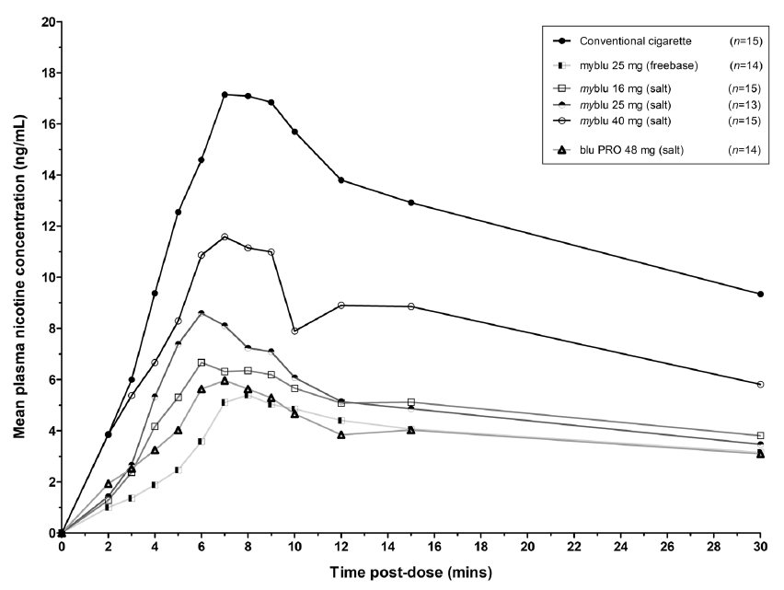
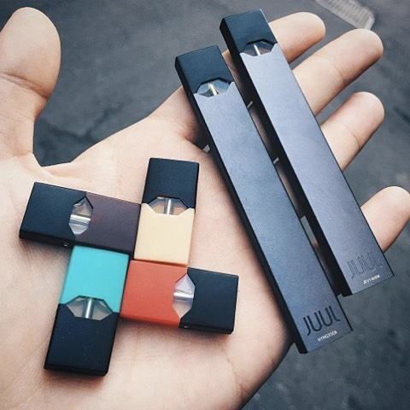
Pod e-cigarettes?
Nicotine delivered quicker than other e-cigarettes (i.e. salt base nicotine vs freebase nicotine)
Easy to use, small, light and sleek appearance

Slide 9
Research questions
What are NIQC smokers’ relative preferences for cigarettes and types of e-cigarette (pod and cig-a-like)?
Can FDA-controlled attributes -nicotine, flavors, health harms- be used to encourage NIQC smokers to switch from cigarettes?
How do these behaviors vary across individual characteristics?

Slide 10
Methods

Slide 11
Methods - overview: Online survey and Discrete choice experiment
Why DCE?
Can obtain data about trade-offs and preferences unobtainable elsewhere
Can analyze preferences beyond current consumption
Why Online survey?
Can obtain a large, representative sample of NIQC
Relatively little wait for data
Obtain exact data needed
Record real beahviours of smokers and use in models
Why both together- combine data on preferences with personal data on smoking, socio-econ and other personal data

Slide 12
Motivating the DCE
Predict impact of policies before implementation
Examine trade-offs between attributes (key for policy)
Incorporate external data into analyses (e.g. survey, policy, PATH)
Causal effects of attributes on choices*
Well-suited to tobacco studies (McFadden, 2014, 2017; Quaife et al., 2018)

Slide 13
Motivating the DCE
Possible to collect up–to–date data
Relatively inexpensive (resources, ethics, etc.)
Easy to administer relative to other study designs (e.g. clinical trial)
Data may not be available elsewhere
Choice models have evolved over last 20 years: very useful behavioural information

Slide 14
Limitations of DCEs
Hypothetical bias
Under-reporting/misreporting (e.g. due to stigma; social desirability bias)
Gaming
Sample size often small
Sampling issues, e.g. selection bias
Requires technical knowledge for design and modelling

Slide 15
Online Survey - content
Desire to quit, determine NIQC
Socio-demographics
Smoking and cessation history
COVID-related questions on health behaviours

Slide 16
Online survey sample and DCE
2,000 NIQC smokers using online platform
Ages 35-85 in US
Not interested in quitting
Smartphone/PC administered
Quotas to match to PATH data (NIQC, age, gender, etc.) – latter had to reduce the threshold level of NIQC to complete the sample

Slide 17
Experimental design: attributes and levels
 | Pod e-cigarette | Cig-a-like | Your own cigarette
Helps you quit cigarettes? | No | No | No
 | Yes | Yes
Healthier than a cigarette? | No | No | No
 | Yes | Yes
Flavors | Tobacco | Tobacco | Respondent's answer
 | Menthol/mint | Menthol/mint
 | Fruit | Fruit
 | Sweet | Sweet
Nicotine per puff/vape | None | None | Same
 | Less | Less
 | Same | Same
 | More | More
Marginal price | 3 |  | Respondent's answer
 | 6 | 6
 | 9 | 9
 |  | 12

Slide 18
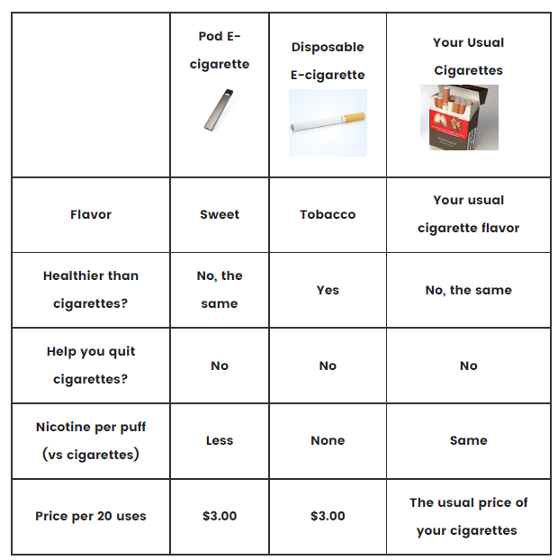
Example choice scenario in this DCE

Slide 19
Multiple choice scenarios
Problem of too many combinations of attributes and levels
Efficient design: Bayesian D-optimal
Use pilot data from 161 respondents to optimize to obtain priors for design
24 choice sets determined
Each respondent sees 12 choice sets-randomized
12 choices balance concerns of learning vs fatigue
Practice scenario to help respondents

Slide 20
Modelling the data
To determine which attributes and levels affect switching to vaping; these are policy relevant factors
To do this, we use a latent class, latent variable choice model that we estimate on the experimental data (i.e. people’s choices in the experiment)
Also use information on smoking, vaping, socio-economic, and COVID-19 variables in the choice model to understand choices

Slide 21
Why use latent class analyses?
Preference heterogeneity – do not assume that all individuals have the same preferences
Classes- there may be policy-relevant groups that respond differently to policies to encourage switching (note the focus is on switching as they are not interested in quitting)
Latent- the groups are not revealed by socio-econ-demo and smoking factors, is a mix of these and choices that reveal the groups; data “speaks for itself”
We ‘name them’ but the groups are based on a variety of factors

Slide 22
Why use latent variable analyses?
COVID-19 was a significant, unexpected shock we wish to control for
Potential impact, or shock, on health behaviors in general – smoking but also drinking, exercise, sleep
And there may be substitution or complementarities among these (Grossman, 1982)
Use a latent variable to capture underlying health behaviors and NIQC smokers’ responses to the pandemic
Based on survey questions on COVID-19 changes in: smoking, drinking, exercise, sleep

Slide 23
Respondent Characteristics (age, gender, etc.)
Latent variable: COVID-19 health behaviours
Class membership
Tobacco Products and Attributes
COVID-19: Smoking
Drinking
Exercise
Sleep
Utility Class 1
Utility Class 2
Observed Choices

Slide 24
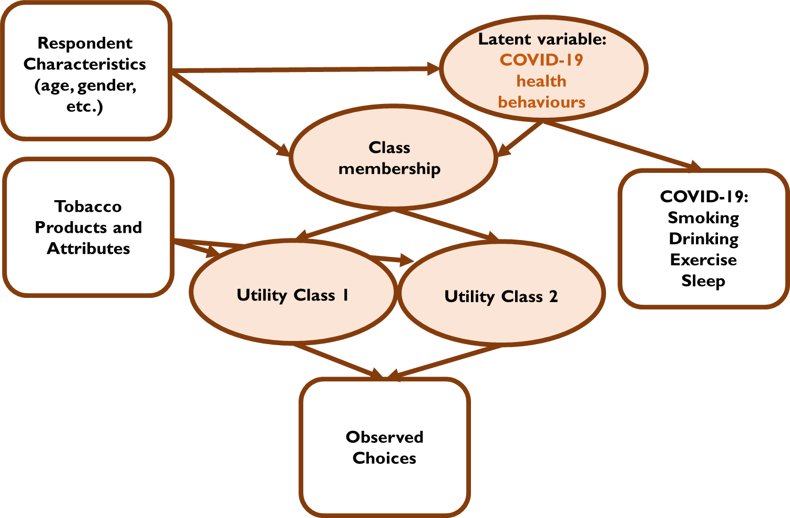
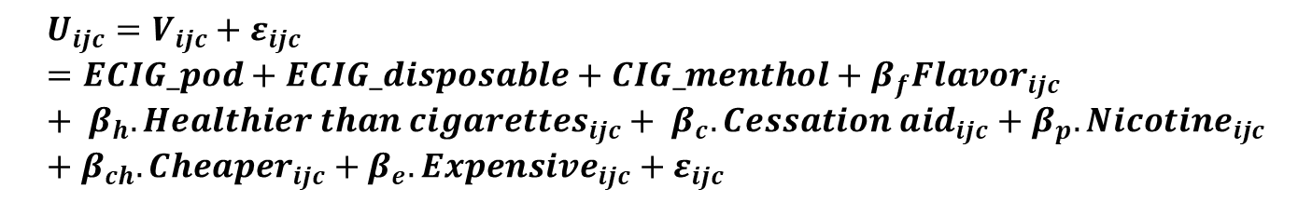
Choice models
Utility function
Utility (i.e. choices) is a function of preferences for cigarette products and their attributes
We estimate betas – tell us how much individuals value each of the products/attributes
$$U_{ijc}=V_{ijc}+ε_{ijc}=ECIG_pod+ECIG_disposable+CIG_menthol+β_{f}{Flavor}_{ijc}+ β_{h}.{Healthier than cigarettes}_{ijc}+ β_{c}.{Cessation aid}_{ijc}+β_{p}.{Nicotine}_{ijc}+β_{ch}.{Cheaper}_{ijc}+β_{e}.{Expensive}_{ijc}+ε_{ijc}$$

Slide 25
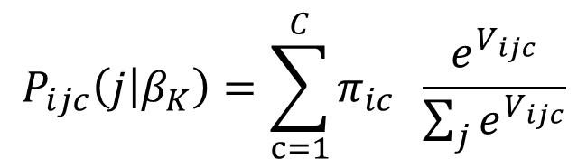
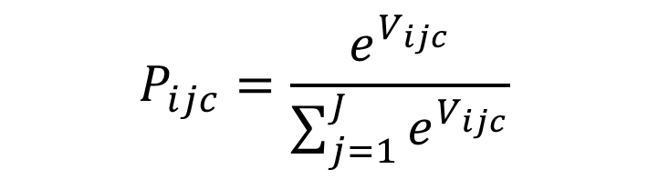
Choice models
Multinomial logit (MNL)
Latent class multinomial logit (LCMNL)
$$P_{ijc}=\frac{e^{V_{ijc}}}{\sum_{j=1}^{J}{e^{V_{ijc}}}}$$
$$P_{ijc}\left(j | β_{K}\right)=\sum_{c=1}^{C}{π_{ic}} \frac{e^{V_{ijc}}}{\sum_{j}{e^{V_{ijc}}}}$$

Slide 26
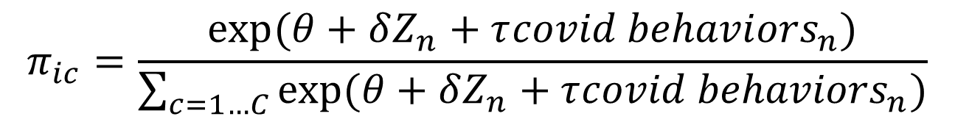
Choice models
Class membership probability
Where Z are individual characteristics; deltas are estimated
Tells us what classes look like in terms of socio-demographics
$$π_{ic}=\frac{exp(θ+δZ_{n}+τ{covid behaviors}_{n})}{\sum_{c=1…C}{exp(θ+δZ_{n}+τ{covid behaviors}_{n})}}$$

Slide 27
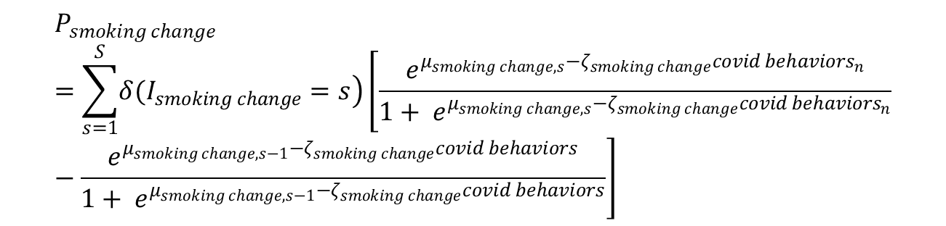
Choice models
Latent variable: measurement equations
Ordered logit as the data is ordered
Smoke: less, the same, more
$$P_{smoking change}=\sum_{s=1}^{S}{\left.δ(I_{smoking change}=s\right)}\left[\frac{e^{μ_{smoking change,s}−ζ_{smoking change}{covid behaviors}_{n}}}{1+ e^{μ_{smoking change,s}−ζ_{smoking change}{covid behaviors}_{n}}}−\frac{e^{μ_{smoking change,s−1}−ζ_{smoking change}covid behaviors}}{1+ e^{μ_{smoking change,s−1}−ζ_{smoking change}covid behaviors}}\right]$$

Slide 28
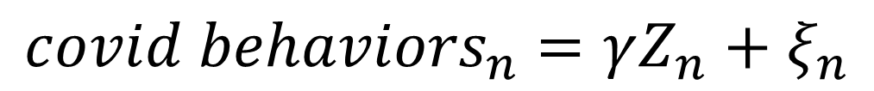
Choice models
Latent variable: structural equation
Z are individual characteristics
Gamma are estimated
$${covid behaviors}_{n}=γZ_{n}+ξ_{n}$$

Slide 29
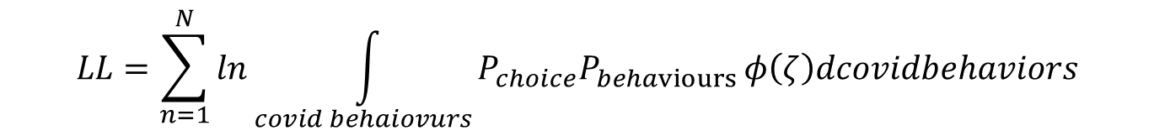
Choice models
Combine all elements in a likelihood function
Use simulated likelihood to estimate joint likelihood
1000 MLHS draws from a normal distribution
$$LL=\sum_{n=1}^{N}{ln}\int_{covid behaiovurs}^{ }{P_{choice}P_{behaviours }φ\left(ζ\right)dcovidbehaviors}$$

Slide 30
Validity, Sensitivity analyses
Coefficients in line with theory
Testing of utility function specification
Removed individuals whose quite interest greater than 5 (108/2000)
Removed individuals who reported not having answered the questionnaire carefully (5/2000; 1923/2000 reported “extremely carefully)
Latent class models with more classes
Mixing distributions within latent classes

Slide 31
Policy Simulations
Start by predicting the current market shares of the three products
Use real world (e.g. price) data in models
Adjust this by using known product use: our model predicts reality (“calibration”)
Then alter the attributes: “what if?” scenarios -> policy simulations
Technique called “sample enumeration” (Train, 2009)

Slide 32
Respondent Characteristics (age, gender, etc.)
Latent variable: COVID-19 health behaviours
Class membership
Tobacco Products and Attributes; Real world data
COVID-19: Smoking
Drinking
Exercise
Sleep
Utility Class 1
Utility Class 2
Observed Choices

Slide 33
Simulations: base case
Individual | Choice Scenario | P(own cigarette) | P(pod) | P(e-cig) | Sum Prob
1 | 1 | 0.7 | 0.1 | 0.2 | 1
1 | 2 | 0.6 | 0.2 | 0.2 | 1
1 | 3 | 0.8 | 0.1 | 0.1 | 1
2 | 1 | 0.6 | 0.4 | 0 | 1
2 | 2 | 0.5 | 0.3 | 0.2 | 1
2 | 3 | 0.9 | 0.1 | 0 | 1
 | Choice shares | 0.68 | 0.20 | 0.12

Slide 34
Simulations: individual 1 is a menthol smoker; menthol ban cigarettes
Individual | Choice Scenario | P(own cigarette) | P(pod) | P(e-cig) | Sum Prob
1 | 1 | 0.5 | 0.2 | 0.3 | 1
1 | 2 | 0.4 | 0.3 | 0.3 | 1
1 | 3 | 0.6 | 0.2 | 0.2 | 1
2 | 1 | 0.6 | 0.4 | 0 | 1
2 | 2 | 0.5 | 0.3 | 0.2 | 1
2 | 3 | 0.9 | 0.1 | 0 | 1
 | Choice shares | 0.58 | 0.25 | 0.17

Slide 35
Results

Slide 36
Descriptive Statistics
 | mean | s.d. | min | max
Age | 51.36 | 11.44 | 35 | 85
Female | .45 | .49 | 0 | 1
Asian | .01 | .11 | 0 | 1
AIAN | .03 | .16 | 0 | 1
Black | .09 | .28 | 0 | 1
White | .86 | .35 | 0 | 1
Hispanic | .05 | .22 | 0 | 1
Higher Education | .34 | .47 | 0 | 1
Quit Interest | 3.16 | 1.85 | 1 | 8
Tobacco Only Smoker | .62 | .49 | 0 | 1
Menthol Only Smoker | .30 | .46 | 0 | 1
Tobacco and Menthol Smoker | .08 | .27 | 0 | 1
Dual User | .19 | .39 | 0 | 1

Slide 37
Latent class choice model
Non-switchers (2 classes)
 |  | Class 1: Non-switchers
Utility Function |  | Estimate | Rob.std.err. | Rob.t-ratio(0)
Pod E-cigarette |  | -5.078 | 0.275 | -18.446
Disposable E-cigarette |  | -3.525 | 0.173 | -20.322
Cigarette Menthol Smoker |  | 0.374 | 0.291 | 1.285
Cheaper |  | 0.062 | 0.010 | 6.545
Expensive |  | -0.024 | 0.011 | -2.154
Helps You Quit |  | -0.469 | 0.126 | -3.714
Healthier Than Cigs |  | -0.289 | 0.118 | -2.452
No Nicotine |  | 0.654 | 0.112 | 5.831
Less Nicotine |  | 0.499 | 0.162 | 3.088
More Nicotine |  | 0.132 | 0.198 | 0.666
Menthol |  | -1.047 | 0.227 | -4.620
Fruit |  | -1.723 | 0.198 | -8.711
Sweet |  | -0.579 | 0.150 | -3.854

Slide 38
Key findings: Non-switchers (68% of sample)
Non-switchers’ product choices
Negative constants imply very strong preferences for their own cigarette
Non-switchers: Attribute preferences
Prefer cheaper products; dislike more expensive products
Dislike e-cigs as cessation aid, healthiness, non-tobacco flavors
Prefer nicotine lower than own

Slide 39
Latent class choice model (2 classes)
 |  |  | Class 2: Switchers
Utility Function |  |  | Estimate | Rob.std.err. | Rob.t-ratio(0)
Pod E-cigarette |  |  | -0.129 | 0.092 | -1.405
Disposable E-cigarette |  |  | -0.363 | 0.087 | -4.193
Cigarette Menthol Smoker |  |  | 0.168 | 0.128 | 1.315
Cheaper |  |  | 0.062 | 0.010 | 6.545
Expensive |  |  | -0.024 | 0.011 | -2.154
Helps You Quit |  |  | -0.032 | 0.032 | -1.007
Healthier Than Cigs |  |  | 0.015 | 0.029 | 0.516
No Nicotine |  |  | 0.170 | 0.028 | 6.158
Less Nicotine |  |  | 0.054 | 0.055 | 0.973
More Nicotine |  |  | 0.070 | 0.047 | 1.492
Menthol |  |  | -0.431 | 0.065 | -6.619
Fruit |  |  | -0.342 | 0.050 | -6.796
Sweet |  |  | -0.357 | 0.050 | -7.173

Slide 40
Key findings: Switchers (32% of sample)
Switchers’ product choices
Non-significant preference pod: indifferent between pod e-cigarettes and their own cigarettes
Negative coefficient on disposable: prefer their own cigarette to disposable e-cigarettes
Switchers: Attribute preferences
Prefer cheaper products; dislike more expensive products
Indifferent to cessation aid, healthiness
Dislike non-tobacco flavors
Prefer nicotine free

Slide 41
Latent class choice model (2 classes)
Class membership probability |  | Estimate | Rob.std.err. | Rob.t-ratio(0)
Constant class 1 |  | 1.287 | 0.113 | 11.395
Older |  | 0.240 | 0.126 | 1.906
Female |  | 0.081 | 0.117 | 0.693
Education |  | -0.647 | 0.118 | -5.484
Income |  | -0.412 | 0.172 | -2.390
Black |  | -0.428 | 0.178 | -2.409
Asian |  | -1.413 | 0.527 | -2.681
Hispanic |  | -0.027 | 0.244 | -0.109
Dual User |  | -1.508 | 0.135 | -11.145
Had COVID |  | -0.163 | 0.180 | -0.934
tau(Latent variable health behaviours) |  | 0.272 | 0.082 | 3.329

Slide 42
Key findings: class membership
“switchers” are more likely to be:
younger,
more educated,
non-white,
use e-cigarettes,
Lower score on LV

Slide 43
Latent class choice model (2 classes)
 | Estimate | Rob.std.err. | Rob.t-ratio(0)
Measurement equations
Zeta (Smoking) | -2.458 | 1.182 | -2.080
Threshold 1 (Smoking) | -6.476 | 1.918 | -3.376
Threshold 2 (Smoking) | -4.732 | 1.438 | -3.290
Threshold 3 (Smoking) | 1.747 | 0.655 | 2.667
Threshold 4 (Smoking) | 3.727 | 1.270 | 2.935
Zeta (Drinking) | -0.982 | 0.207 | -4.731
Threshold 1 (Drinking) | -2.602 | 0.210 | -12.391
Threshold 2 (Drinking) | -2.205 | 0.194 | -11.363
Threshold 3 (Drinking) | 1.700 | 0.107 | 15.885
Threshold 4 (Drinking) | 3.032 | 0.173 | 17.508
Zeta (Exercise) | 0.222 | 0.095 | 2.332
Threshold 1 (Exercise) | -2.060 | 0.071 | -28.922
Threshold 2 (Exercise) | -1.274 | 0.055 | -23.196
Threshold 3 (Exercise) | 1.706 | 0.068 | 25.134
Threshold 4 (Exercise) | 3.099 | 0.114 | 27.284
Zeta (Sleep) | -0.008 | 0.088 | -0.088
Threshold 1 (Sleep) | -2.332 | 0.080 | -29.294
Threshold 2 (Sleep) | -1.134 | 0.055 | -20.806
Threshold 3 (Sleep) | 1.537 | 0.061 | 25.028
Threshold 4 (Sleep) | 2.789 | 0.097 | 28.742

Slide 44
Key findings: measurement equations
Higher score on latent variable associated with:
Smoking less
Drinking less
Exercising more
-> non-switchers healthier behaviours during pandemic

Slide 45
Latent class choice model (2 classes)
 | Estimate | Rob.std.err. | Rob.t-ratio(0)
Older | 0.351 | 0.375 | 0.937
Female | -0.259 | 0.074 | -3.500
Higher education | -0.049 | 0.136 | -0.360
Income | 0.020 | 0.138 | 0.148
Black | 0.027 | 0.221 | 0.120
Asian | 0.031 | 0.225 | 0.137

Slide 46
Key findings: Structural equation
Higher score on latent variable associated with:
Male
-> most of the deterministic heterogeneity channelled through the characteristics directly rather than via the LV

Slide 47
Policy simulations
Simulation |  | Product |  | Choice share
 |  |  |  | Class 1 | Class 2 | Total | % change from baseline
Calibrated, baseline |  | Cigarette |  | 1.00 | 0.56 | 0.86 | -
Calibrated, baseline |  | Pod e-cigarette |  | 0.00 | 0.28 | 0.09 | -
Calibrated, baseline |  | Disposable e-cigarette |  | 0.00 | 0.16 | 0.05 | -
Calibrated, menthol cigarette ban |  | Cigarette |  | 1.00 | 0.55 | 0.85 | -0.5%
Calibrated, menthol cigarette ban |  | Pod e-cigarette |  | 0.00 | 0.28 | 0.09 | 2.7%
Calibrated, menthol cigarette ban |  | Disposable e-cigarette |  | 0.00 | 0.17 | 0.05 | 2.8%
Calibrated, cigarette taxes |  | Cigarette |  | 1.00 | 0.53 | 0.85 | -1.0%
Calibrated, cigarette taxes |  | Pod e-cigarette |  | 0.00 | 0.28 | 0.09 | 3.1%
Calibrated, cigarette taxes |  | Disposable e-cigarette |  | 0.00 | 0.18 | 0.06 | 11.5%

Slide 48
Key findings Policy Simulations
Only switchers responsive to policies
More effect through prices than menthol
Disposable e-cigarettes gained more share than pod e-cigarettes
Both policies limited impact: very few choices away from cigarettes

Slide 49
Discussion

Slide 50
Summary
We used a DCE to examine NIQC smokers’ product preferences
Asked if NIQC smokers could be encouraged to switch to pod e-cigarettes
Simulated the potential impacts of FDA policy changes

Slide 51
In sum-key findings overall
Two classes of NIQC smoker: those with very strong preferences for their own cigarettes; and those who would choose e-cigarettes
Non-switchers’ choices do not appear to be impacted by attribute variation (i.e. policy changes)
Switchers’ choices are responsive to menthol bans and taxes, but to a limited degree
Switchers were: younger, educated, Black, Asian, and users of e-cigarettes

Slide 52
Discussion (i)
Switchers are the only group likely to be responsive to policies or other approaches to get them to switch. Focus should be on them.
E-cigarette flavors do not impact choices. Banning them does not deter switching among NIQC smokers. Good for wider regulatory picture (i.e. youth vaping).
Nicotine levels in e-cigarettes did not appear to attract NIQC smokers. Lowering nicotine levels does not deter switching among NIQC smokers. Good for wider regulatory picture (i.e. youth vaping).

Slide 53
Discussion (ii)
Prices only marginally impact choices: taxes’/subsidies’ impact
Take home: None of the policies studied appear to impact on these smokers’ short-term choices
Other policies should be considered to encourage switching (Begh et al., 2020; Buckell et al., 2020)

Slide 54
Thank you
john.buckell@ndph.ox.ac.uk

